Slide 1
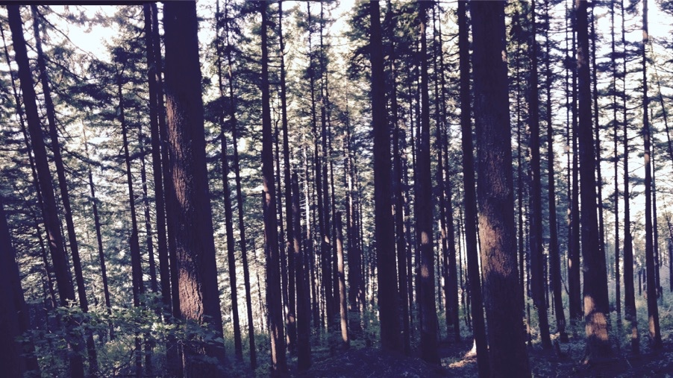
Using least cost optimality to reliably simulate photosynthetic acclimation
Nick Smith
Department of Biological Sciences
Texas Tech University

Slide 2
Plants acclimate to environmental conditions
nick.smith@ttu.edu; @nick_greg_smith
Level of operation
Population
Plant
Acclimation
Leaf
Instantaneous response
Cell
Seconds
Minutes
Days
Years
Response time
Smith and Dukes (2013)

Slide 3
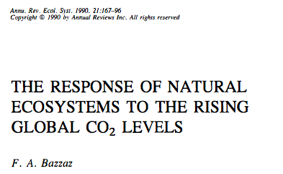
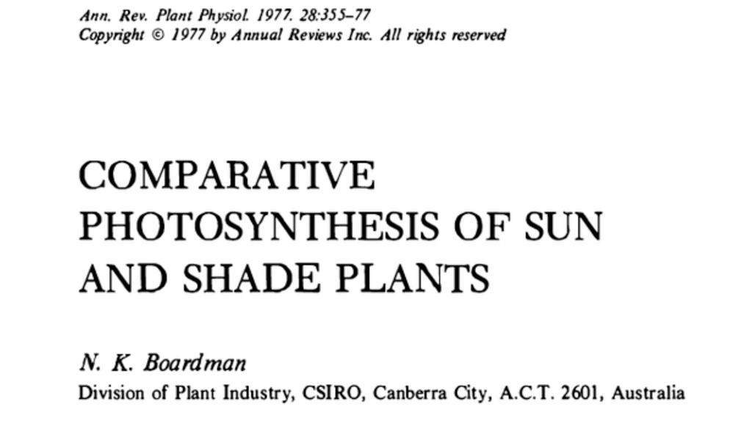
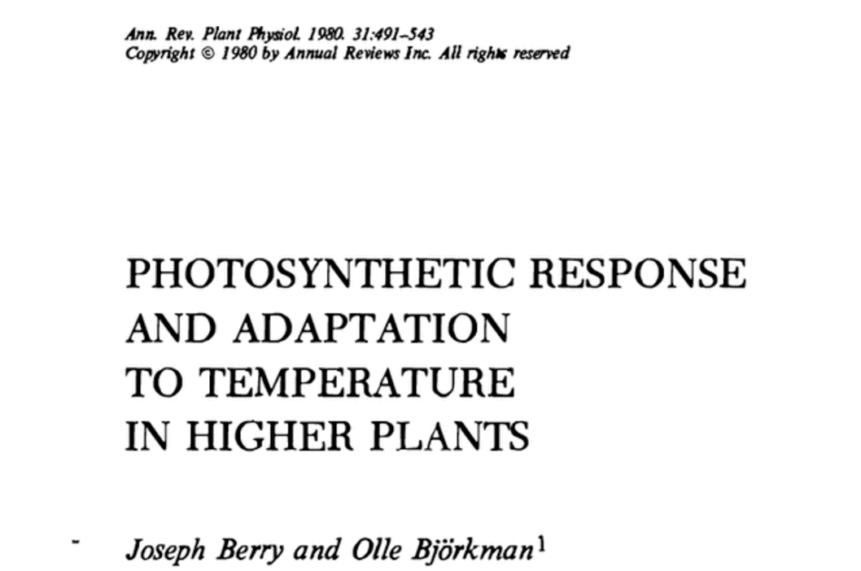
Photosynthetic acclimation is ubiquitous and well known…
nick.smith@ttu.edu; @nick_greg_smith
Temperature: Berry & Björkman (1980)
CO₂: Bazzaz (1990)
Light: Boardman (1977)

Slide 4
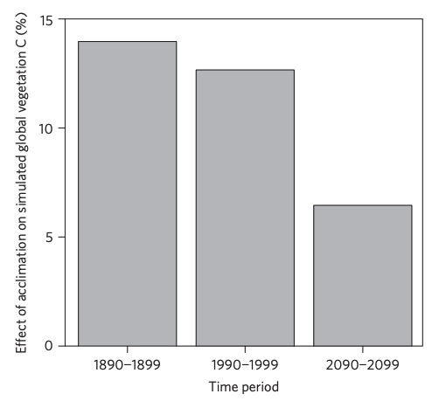
…and can possibly impact carbon cycling and climate
nick.smith@ttu.edu; @nick_greg_smith
Acclimation increase future C storage by ~6%
Acclimation alters future temperature by >1°C
Smith et al. (2017) Nature Climate Change
Smith et al. (2017) JAMES

Slide 5
Here’s the problem: No theoretical model for photosynthetic acclimation exists
nick.smith@ttu.edu; @nick_greg_smith

Slide 6
Lack of theory results in…
nick.smith@ttu.edu; @nick_greg_smith

Slide 7
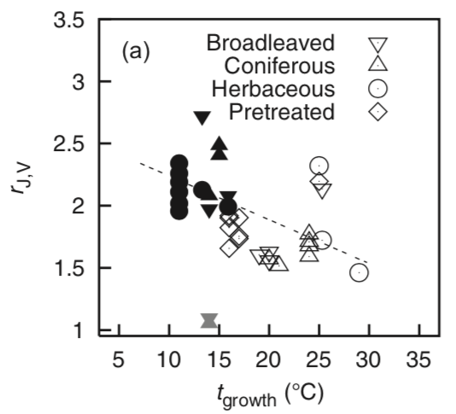
Lack of theory results in…
nick.smith@ttu.edu; @nick_greg_smith
Unreliable future predictions (overparameterization, tuning)
Reliance on statistical models
Resulting change in simulated photosynthesis
Physiological parameter
Environmental condition
Kattge and Knorr (2007) PC&E
Smith et al. (2017) JAMES

Slide 8
So, we developed a mechanistic model of photosynthetic acclimation Based on least cost optimization and the first principles of plant physiological theory
nick.smith@ttu.edu; @nick_greg_smith

Slide 9
Least cost theory
nick.smith@ttu.edu; @nick_greg_smith
Maintain fastest rate of photosynthesis at the lowest cost (water and nutrient use)
Wright et al. (2003) American Naturalist

Slide 10
Optimal photosynthesis
nick.smith@ttu.edu; @nick_greg_smith
Photosynthesis = f{stomatal conductance,
photosynthetic biochemistry}

Slide 11
Optimal photosynthesis
nick.smith@ttu.edu; @nick_greg_smith
Photosynthesis = f{stomatal conductance,
photosynthetic biochemistry}
Must predict optimal rates of both

Slide 12
Optimal photosynthesis
nick.smith@ttu.edu; @nick_greg_smith
Photosynthesis = f{stomatal conductance,
photosynthetic biochemistry}

Slide 13
Optimal photosynthesis
nick.smith@ttu.edu; @nick_greg_smith
Photosynthesis = f{stomatal conductance,
photosynthetic biochemistry}
OTPIMAL CONDUCTANCE IS NOW COMMONPLACE IN MOST MODELS
e.g., Prentice et al. (2014), Medlyn et al. (2011)

Slide 14
Optimal photosynthesis
nick.smith@ttu.edu; @nick_greg_smith
Photosynthesis = f{stomatal conductance,
photosynthetic biochemistry}

Slide 15
Biochemistry optimization: Coordination hypothesis
nick.smith@ttu.edu; @nick_greg_smith
Plant biochemistry setup will aim for equal limitation by all factors

Slide 16
nick.smith@ttu.edu; @nick_greg_smith
A_{j} = A_{c}
A_{j} = f{light, T, CO₂}
A_{c} = f{V_{cmax}, T, CO₂}
Smith et al. (2019)

Slide 17
nick.smith@ttu.edu; @nick_greg_smith
V_{cmax} = f {light, T, CO₂}
Smith et al. (2019)

Slide 18
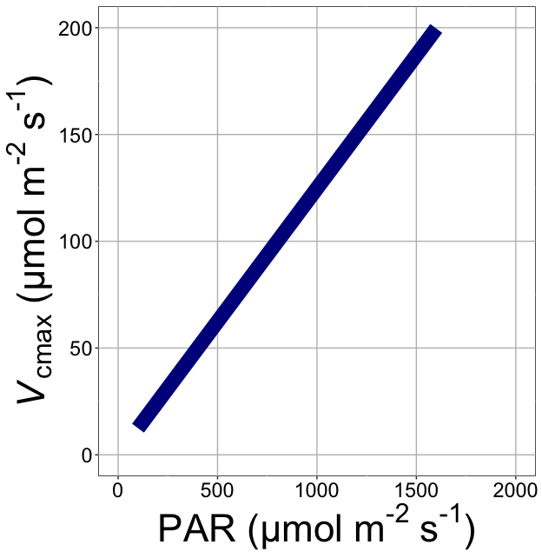
nick.smith@ttu.edu; @nick_greg_smith
V_{cmax} increases with light because of greater electron transport
Smith et al. (2019)

Slide 19
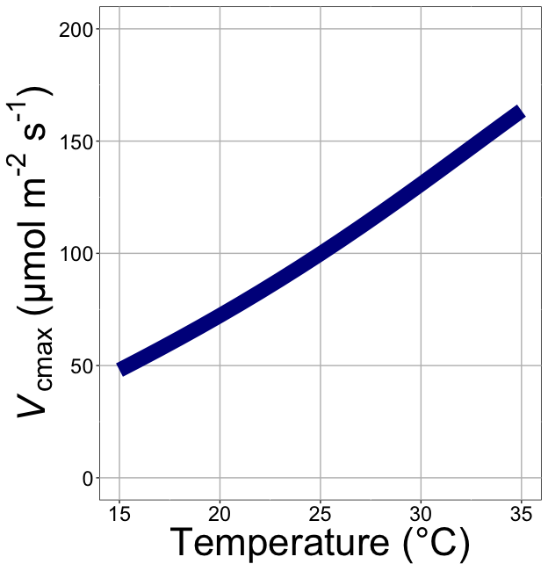
nick.smith@ttu.edu; @nick_greg_smith
V_{cmax} increases with temperature because of greater electron transport and photorespiration
Smith et al. (2019)

Slide 20
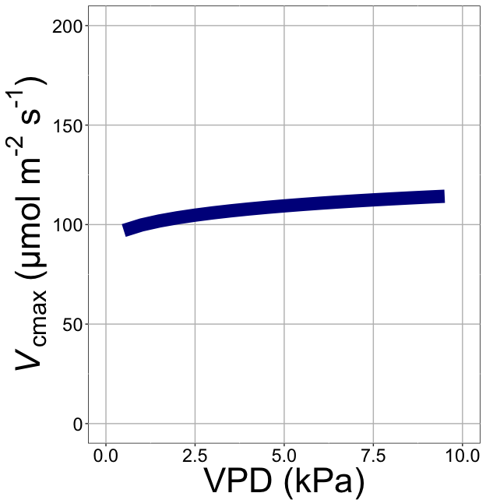
nick.smith@ttu.edu; @nick_greg_smith
V_{cmax} increases with VPD because of lower stomatal conductance
Smith et al. (2019)

Slide 21
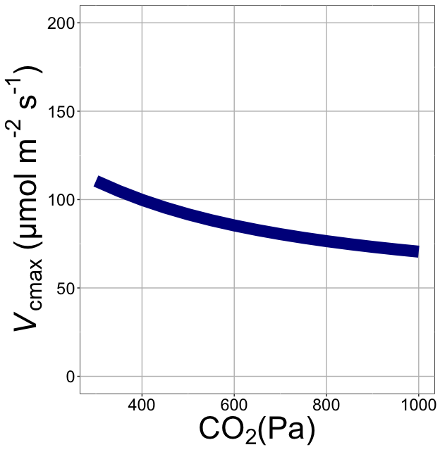
nick.smith@ttu.edu; @nick_greg_smith
V_{cmax} decreases with CO₂ because of greater CO₂ in the leaf
(ppm)
Smith et al. (2019)

Slide 22
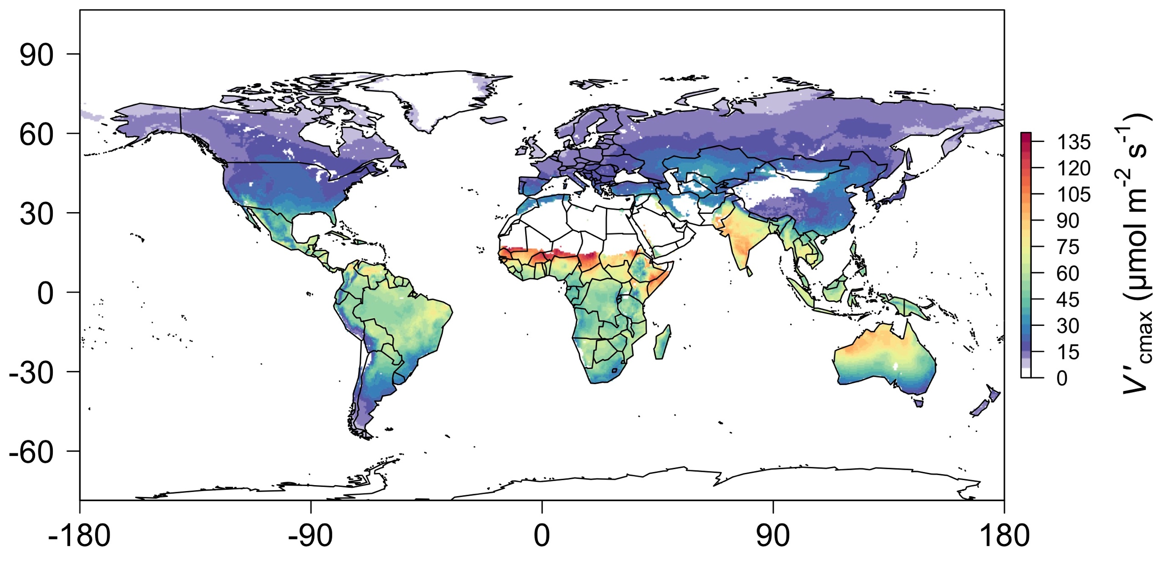
nick.smith@ttu.edu; @nick_greg_smith
Global, optimally acclimated traits!
Smith et al. (2019)

Slide 23
Important note: optimality model adds no free parameters to Farquhar model
nick.smith@ttu.edu; @nick_greg_smith

Slide 24

Let’s run a model out into the future!
nick.smith@ttu.edu; @nick_greg_smith

Slide 25
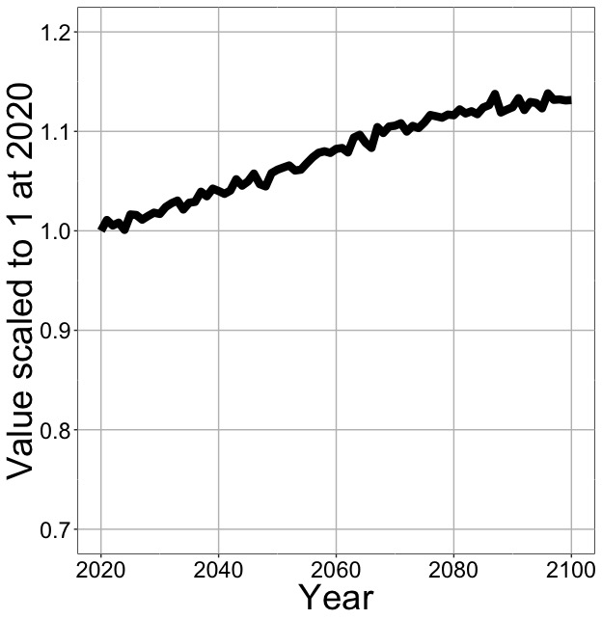
Photosynthesis increases in future
nick.smith@ttu.edu; @nick_greg_smith
Net Photosynthesis
Smith et al. (in prep)

Slide 26
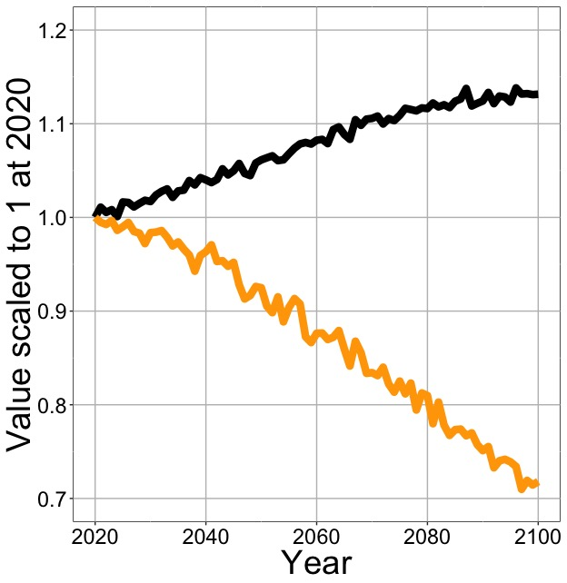
Photosynthesis increases in future (at lower nutrient use)
nick.smith@ttu.edu; @nick_greg_smith
Net Photosynthesis
Leaf Nitrogen
Smith et al. (in prep)

Slide 27
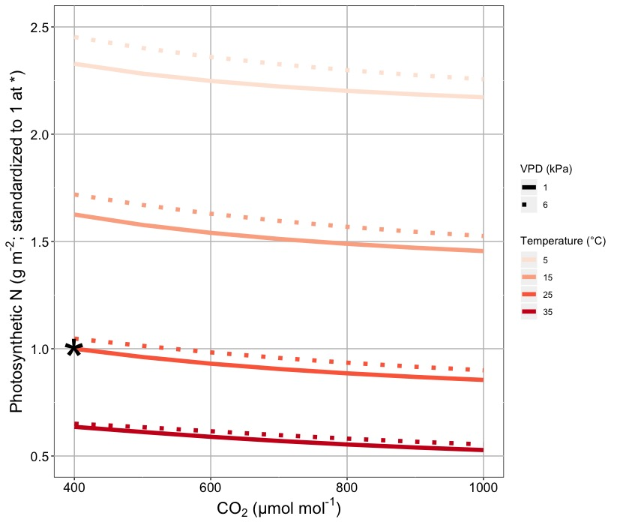
Leaf N declines due to warming and eCO₂
nick.smith@ttu.edu; @nick_greg_smith
Smith & Keenan (in review)

Slide 28
Photosynthesis increases in future (at lower nutrient use)
nick.smith@ttu.edu; @nick_greg_smith
Net Photosynthesis
Leaf Nitrogen
Smith et al. (in prep)

Slide 29
Photosynthesis increases in future (at lower nutrient use)
nick.smith@ttu.edu; @nick_greg_smith
Net Photosynthesis
Base ELM shows <5% change in leaf N
Leaf Nitrogen
Smith et al. (in prep)

Slide 30
What does this all mean and is it real?
nick.smith@ttu.edu; @nick_greg_smith

Slide 31
A typical LSM photosynthesis scheme
nick.smith@ttu.edu; @nick_greg_smith
Climate
Soil N
Leaf N
Photosynthesis

Slide 32
Least cost optimality model
nick.smith@ttu.edu; @nick_greg_smith
Climate
Photosynthesis

Slide 33
Let’s check this assumption
nick.smith@ttu.edu; @nick_greg_smith
Climate
Soil N
Leaf N
Photosynthesis

Slide 34
Does leaf N respond to soil N?
nick.smith@ttu.edu; @nick_greg_smith
Each box is proportional to the variance in leaf N explained by each variable
Smith et al. (in prep)

Slide 35
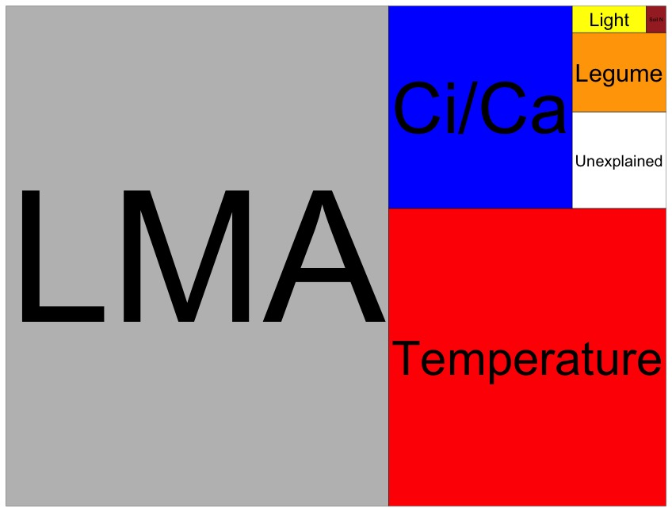
Globally, N addition little impact on leaf N
nick.smith@ttu.edu; @nick_greg_smith
Each box is proportional to the variance in leaf N explained by each variable
Smith et al. (in prep)

Slide 36
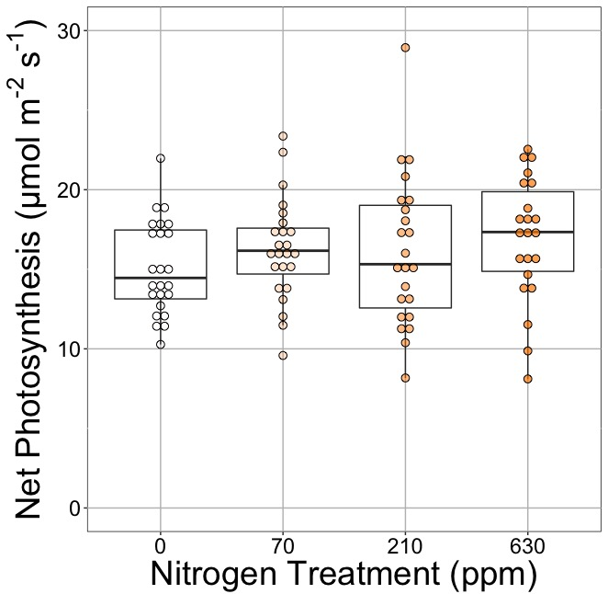
Does photosynthesis respond to soil N?
nick.smith@ttu.edu; @nick_greg_smith
Waring and Smith (in prep)

Slide 37
Photosynthesis does not change with soil N
nick.smith@ttu.edu; @nick_greg_smith
No change (P = 0.42)
Waring and Smith (in prep)

Slide 38
How does the optimality model do?
nick.smith@ttu.edu; @nick_greg_smith
Climate
Photosynthesis

Slide 39

nick.smith@ttu.edu; @nick_greg_smith
Optimal V_{cmax} is similar to observed values
Smith et al. (2019)

Slide 40
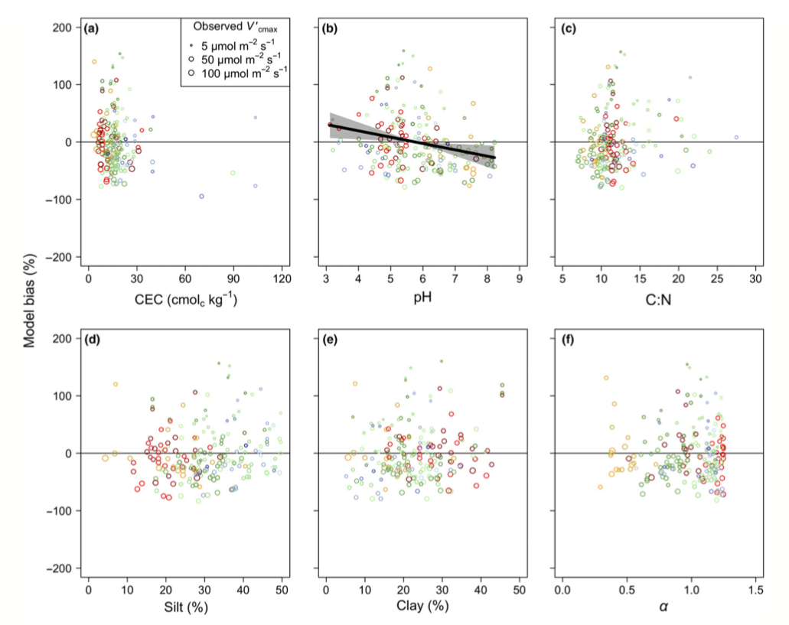
There is little effect of soils on V_{cmax}
nick.smith@ttu.edu; @nick_greg_smith
Soil increased explained variation from 64% to 68% compared to optimal response alone
Smith et al. (2019)

Slide 41
Does it work under future conditions?

Slide 42
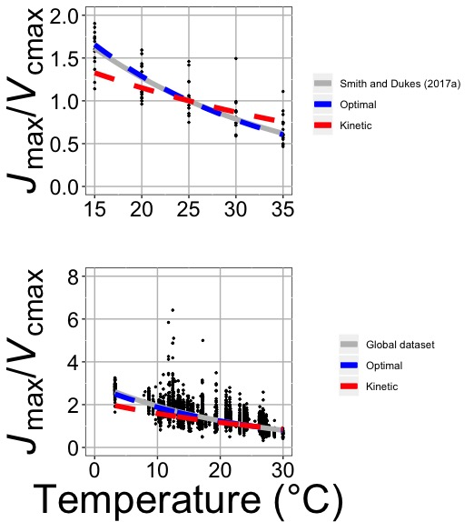
Photosynthetic traits change with temperature in ways expected from optimization
nick.smith@ttu.edu; @nick_greg_smith
Data = -0.051 °C⁻¹
Predicted = -0.048 °C⁻¹
Smith and Keenan (in review)

Slide 43
Photosynthetic traits change with future conditions in ways expected from optimization
nick.smith@ttu.edu; @nick_greg_smith
mean: -12%
mean: -15%
(P > 0.05)
Smith and Keenan (in review)

Slide 44
Implications

Slide 45
Implications
Optimal leaf biochemical setup is determined by climate

Slide 46
Implications
Optimal leaf biochemical setup is determined by climate
Plants mine for N to get the most leaves at the optimal setup

Slide 47
Implications
Optimal leaf biochemical setup is determined by climate
Plants mine for N to get the most leaves at the optimal setup
Photosynthetic demand determines leaf N, not the other way around

Slide 48
Axes need flipped
Kattge et al. (2009)

Slide 49
Implications
Optimal leaf biochemical setup is determined by climate
Plants mine for N to get the most leaves at the optimal setup
Photosynthetic demand determines leaf N, not the other way around
Soil N determines # of leaves (before canopy closure)

Slide 50
What’s going on?
Optimal leaf biochemical setup is determined by climate
Plants mine for N to get the most leaves at the optimal setup
Photosynthetic demand determines leaf N, not the other way around
Soil N determines # of leaves (before canopy closure)

Slide 51
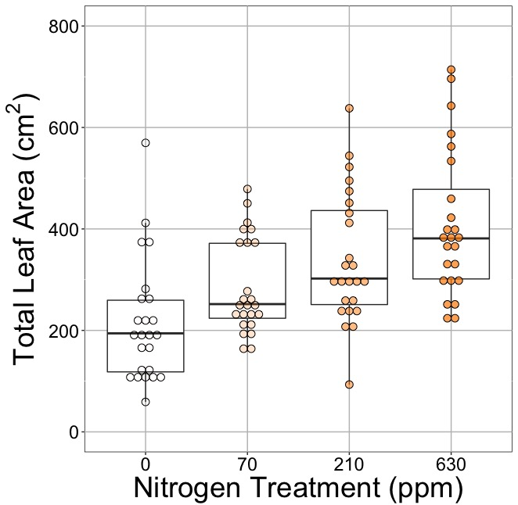
Soil N determines # of leaves?
nick.smith@ttu.edu; @nick_greg_smith
No change (P = 0.42)
91% increase (P < 0.05)
Waring and Smith (in prep)

Slide 52
Next steps: How might this effect simulated nutrient limitation?
nick.smith@ttu.edu; @nick_greg_smith
“No limitation” simulation
“Nutrient limitation” simulations
Weider et al. (2015)

Slide 53
Conclusions
nick.smith@ttu.edu; @nick_greg_smith
Plants aren’t dumb!
Need to make sure our models reliably simulate acclimation responses
Dumb plants

Slide 54
Conclusions
nick.smith@ttu.edu; @nick_greg_smith
Photosynthetic acclimation is likely to impact ecosystem-scale processes
Allocation
N cycling
Microbial processes (e.g., symbioses)

Slide 55
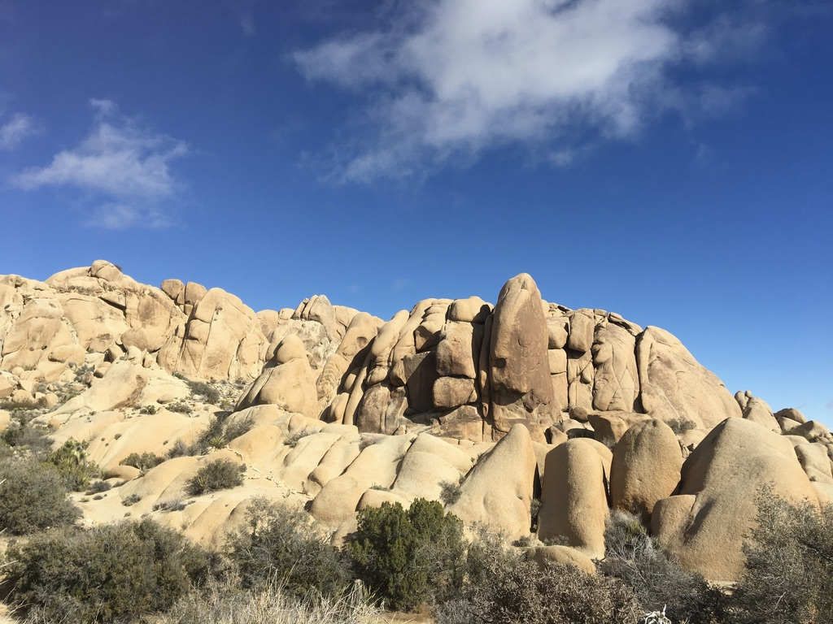
nick.smith@ttu.edu; @nick_greg_smith
Presentation available at:
www.github.com/SmithEcophysLab/seminar/lmwg_2020
Thanks!

Slide 56
Extra slides

Slide 57
Leaf area, but not photosynthesis increases with N addition
nick.smith@ttu.edu; @nick_greg_smith
No change (P = 0.42)
91% increase (P < 0.05)
Waring and Smith (in prep)

Slide 58
nick.smith@ttu.edu; @nick_greg_smith
Open stomata:
Benefits
High CO₂ influx
Costs
High water outflux
Closed stomata:
Benefits
Low water outflux
Costs
Low CO₂ influx

Slide 59
nick.smith@ttu.edu; @nick_greg_smith
Open stomata:
Benefits
High CO₂ influx
Costs
High water outflux
Closed stomata:
Benefits
Low water outflux
Costs
Low CO₂ influx
Must maintain high amount of Rubisco to do photosynthesis

Slide 60
Optimal stomatal conductance
nick.smith@ttu.edu; @nick_greg_smith
Optimal conductance maximizes photosynthesis at least water loss and nutrient use
Water loss is from transpiration
Nutrient use is nutrients used to maintain Rubisco
Rubisco proxy is V_{cmax}

Slide 61
Stomatal conductance trait The ratio of CO₂ in the leaf to CO₂ outside of the leaf (C_{i}/C_{a})
nick.smith@ttu.edu; @nick_greg_smith

Slide 62
nick.smith@ttu.edu; @nick_greg_smith
C_{i}/C_{a} = f{temperature,
CO₂,
vapor pressure deficit}
Prentice et al. (2014); Wang et al. (2017); Smith et al. (2019)

Slide 63
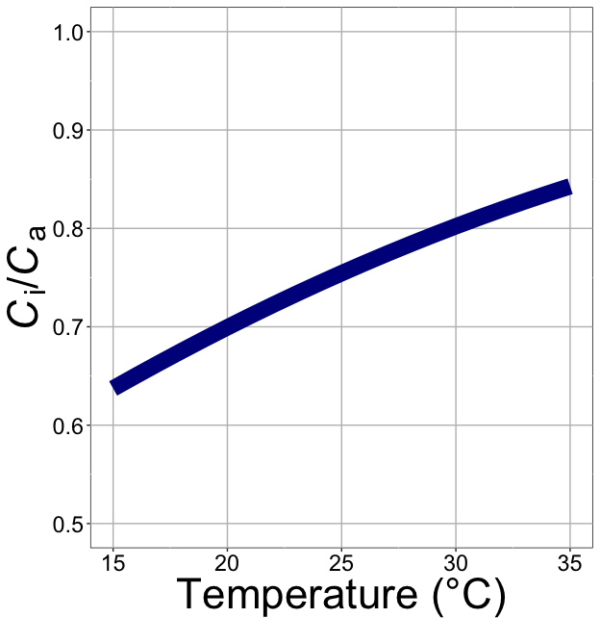
nick.smith@ttu.edu; @nick_greg_smith
C_{i}/C_{a} increases with temperature because of greater photorespiration
Smith et al. (2019)

Slide 64
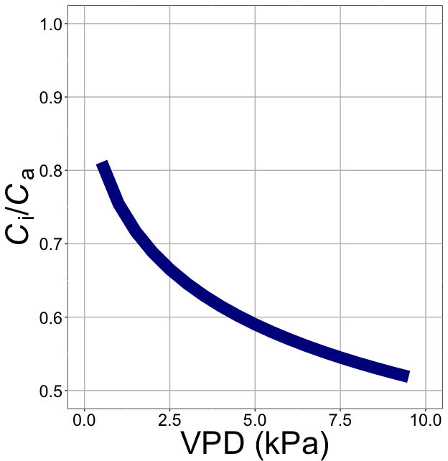
nick.smith@ttu.edu; @nick_greg_smith
C_{i}/C_{a} decreases with VPD because of greater water loss
Smith et al. (2019)

Slide 65
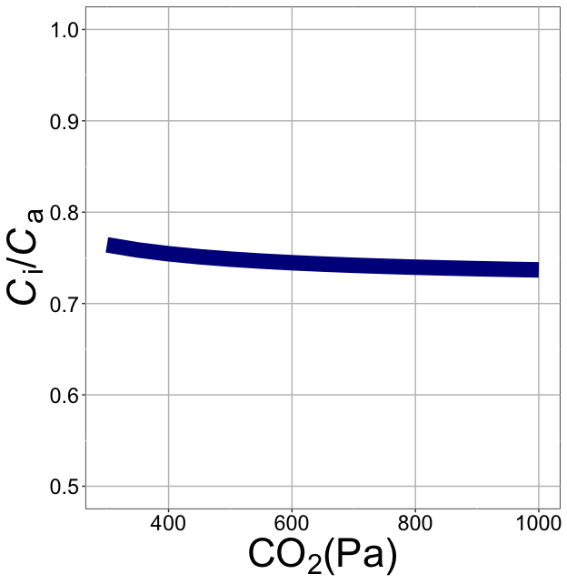
nick.smith@ttu.edu; @nick_greg_smith
C_{i}/C_{a} decreases with CO₂ because of lower openness needed to satisfy Rubisco
Smith et al. (2019)

Slide 66
Photosynthetic acclimation can be seen as the change in the instantaneous responses with longer-term exposure
nick.smith@ttu.edu; @nick_greg_smith
Acclimated to high light

Slide 67
Photosynthetic acclimation can be seen as the change in the instantaneous responses with longer-term exposure
nick.smith@ttu.edu; @nick_greg_smith
Acclimated to high light
Acclimated to low light

